Slide 1
SELLER GUIDANCE
Deck Overview
Purpose:
Audience:
Deck Usage Guidance
Customer roles:
Benefits:
Case studies:
Additional Resources
Other industries:
For more information: contact
DELETE THIS SLIDE BEFORE PRESENTING

Slide 2
Microsoft Azure IoT Suite Achieving Digital Transformation

Slide 3


Digital transformation is rapidly reshaping the landscape
“Every business will become a software business, build applications, use advanced analytics and provide SaaS services.“
- Satya Nadella
~80%
driven by apps, analytics, and services in 2020
Intelligence
margin¹
Average increase in income for the most digitally transformed enterprises
$100M
²
Income
2020
30B
²
Things
2009
Sources: ¹McKinsey, How IoT Can Support A Dynamic Maintenance Program, 2016
²IDC, 2016
Notes:
Notes: Microsoft CEO Satya Nadella presented this slide at convergence last month and I really love this slide as it puts the IoT wave in context with simplicity.
Let us start with the graph – if you go by different market research studies, by 2019 it is expected by more than 26B devices (machines, sensors, gateways etc.) are expected to be connected to cloud. These “things” are expected to generate 44ZB of data. To put things in perspective, 1 zettabyte = 1Billion gigabytes.
<Add Yottabyte=1000 ZB if useful>
The current hypothesis is that the intelligence gleaned from this data (there is a big if”) can help create new business models akin to software with 80% gross margin. This for me in way translates to the fact that Enterprises in any industry will have to manage software/apps as part of their core business portfolio.
What this all means, there is a shift from systems of record to systems of intelligence. The Internet of Things is a key element of that shift to systems of intelligence.
IDC details: MacGillivray, Carrie, Worldwide Internet of Things Forecast Update, 2015-2019, International Data Corporation (IDC), February 2016.

Slide 4
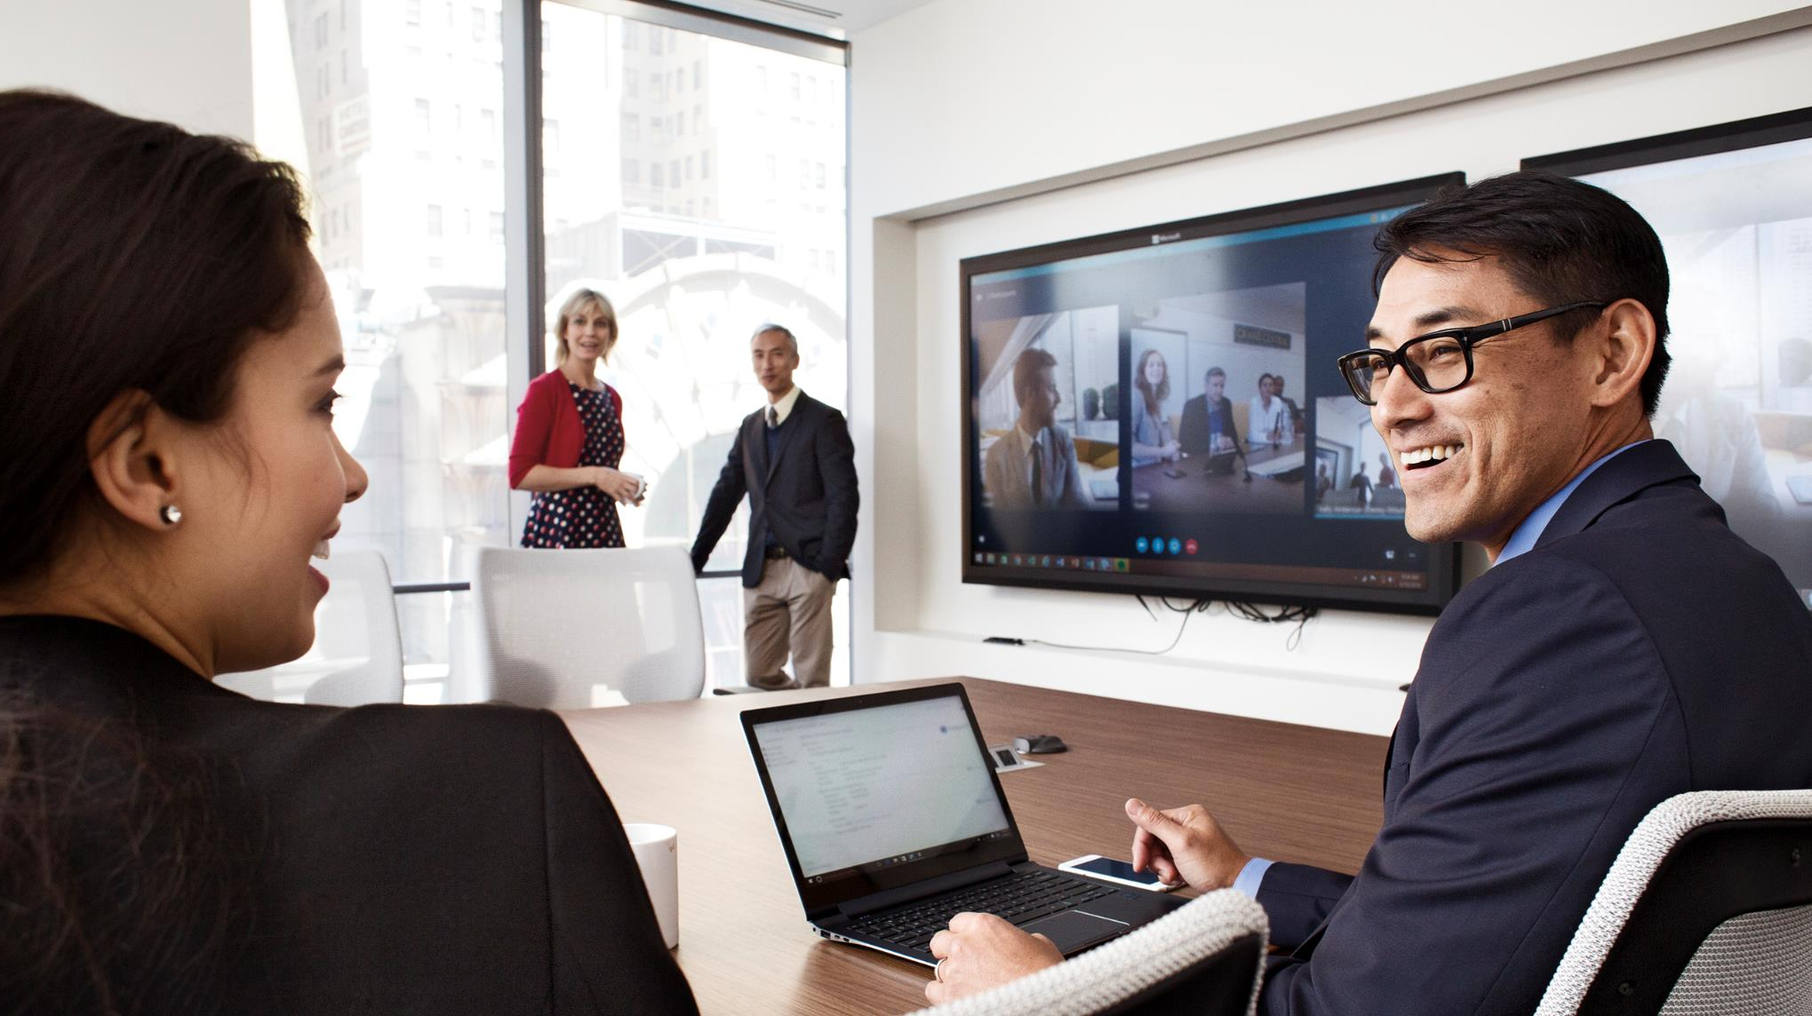
Digital transformation hinges on four imperatives
Engage your
customers
Transform
your products
Systems of
Intelligence
Empower your
employees
Optimize your
operations
Notes:
Transformation requires rich systems of intelligence. And it isn’t simply about technology…systems of intelligence represent the combination of technology, people and process that enable these feedback loops, and define an organization’s competitiveness and ability to change the entire landscape of the industries in which it participates.

Slide 5

The Internet of Things is the key to digital transformation
According to a recent IoT survey…
73%
Of the companies surveyed are currently active in IoT
60%
Of those working on IoT are aiming to grow revenue and profits
50%
Reduction in downtime with predictive maintenance
Source: Redefining the Connected Conversation, IoT Trends, Challenges & Experience Survey. James Brehm & Associates, 2016.
Notes:
Goal: instill sense of urgency. Customers are all moving into IoT. Get on the bus.

Slide 6









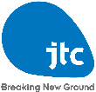













IoT is already delivering tangible results
Chillers now run 9x faster than unconnected equipment, avoiding more than $300,000 in hourly downtime costs
Gathers data from sensors and systems to create valuable business intelligence and reduce downtime by 50%
Cutting fuel usage by 1 percent could save $250,000 per plane per year
Improves access to production and supply chain data worldwide, reducing downtime costs by as much as $300,000 per day
Notes:
While there are a lot of interesting IoT scenarios unfolding in the consumer space, based on our experience in working with customers and partners we see the majority of IoT value being enabled in the commercial space.
This is backed by a recently released McKinsey report that states that 70% of the value enabled by IoT will come from B2B scenarios.
Whether its Rockwell Automation, from whom you'll hear from later on today, that is helping its oil and gas customers improve efficiency by monitoring supply chain assets, or ThyssenKrupp elevators that is doing predictive maintenance on elevators to prevent unscheduled downtime for their customers, or the Stanford Linear Accelerator Center (SLAC) that is using IoT to continuously monitor various sensors of the linear accelerator to anticipate problems, take action and prevent failure; organization of all types are starting to harness the value of IoT to transform themselves.
Of course, as a solution provider you could very well be working with a customer that's creating a consumer product, let's say a car manufacturer. However, the value you'll be providing in this B2B2C scenario is helping that organization build an enterprise grade IoT solution so they can launch their products.
Our focus here is simply to enable build enterprise grade internet of their things solutions for your customers. Our goal is to provide you the best platform to do this.

Slide 7
Innovation at work – real world IoT use cases
Street sweepers
Aircrafts
Auto
Cows
Electric charging stations
Fryers
Oil equipment
Vending machines
Dogs
Buses
Power plant
Internet of Things
Buildings
Factory floor
Racing
Trucks
Oil distribution
Elevators
Power tools
Vaccine dispensers
Mining equipment
Surveillance
Postboxes
Engines
Smart meters
Smart grids
Medical devices
Notes:
While there are a lot of interesting IoT scenarios unfolding in the consumer space, based on our experience in working with customers and partners we see the majority of IoT value being enabled in the commercial space.
This is backed by a recently released McKinsey report that states that 70% of the value enabled by IoT will come from B2B scenarios.
Whether its Rockwell Automation, from whom you'll hear from later on today, that is helping its oil and gas customers improve efficiency by monitoring supply chain assets, or ThyssenKrupp elevators that is doing predictive maintenance on elevators to prevent unscheduled downtime for their customers, or the Stanford Linear Accelerator Center (SLAC) that is using IoT to continuously monitor various sensors of the linear accelerator to anticipate problems, take action and prevent failure; organization of all types are starting to harness the value of IoT to transform themselves.
Of course, as a solution provider you could very well be working with a customer that's creating a consumer product, let's say a car manufacturer. However, the value you'll be providing in this B2B2C scenario is helping that organization build an enterprise grade IoT solution so they can launch their products.
Our focus here is simply to enable build enterprise grade internet of their things solutions for your customers. Our goal is to provide you the best platform to do this.

Slide 8
IoT in your industry

Slide 9

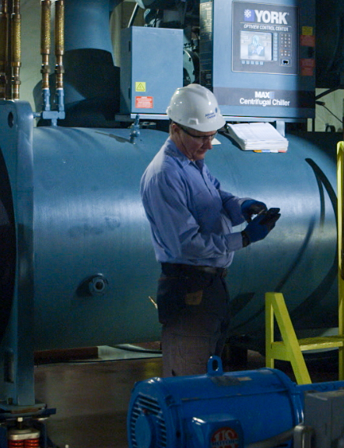
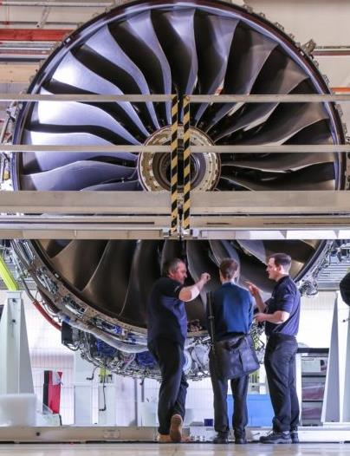



Manufacturing (1 of 2)
Moving from action to insights
Reduced development time and cost by 80% by gathering and analyzing data more efficiently and increasing automation across the company.
Click to learn more
Building efficiency with IoT
“Smart Connected Chillers” initiative collected approximately 14 million records each day to inform more efficient building equipment.
Filtering the signal from the noise
Used analytics to discover actionable insights around fuel usage, predictive maintenance and stop unscheduled delays.
Click to learn more
Notes:
While there are a lot of interesting IoT scenarios unfolding in the consumer space, based on our experience in working with customers and partners we see the majority of IoT value being enabled in the commercial space.
This is backed by a recently released McKinsey report that states that 70% of the value enabled by IoT will come from B2B scenarios.
Whether its Rockwell Automation, from whom you'll hear from later on today, that is helping its oil and gas customers improve efficiency by monitoring supply chain assets, or ThyssenKrupp elevators that is doing predictive maintenance on elevators to prevent unscheduled downtime for their customers, or the Stanford Linear Accelerator Center (SLAC) that is using IoT to continuously monitor various sensors of the linear accelerator to anticipate problems, take action and prevent failure; organization of all types are starting to harness the value of IoT to transform themselves.
Of course, as a solution provider you could very well be working with a customer that's creating a consumer product, let's say a car manufacturer. However, the value you'll be providing in this B2B2C scenario is helping that organization build an enterprise grade IoT solution so they can launch their products.
Our focus here is simply to enable build enterprise grade internet of their things solutions for your customers. Our goal is to provide you the best platform to do this.

Slide 10
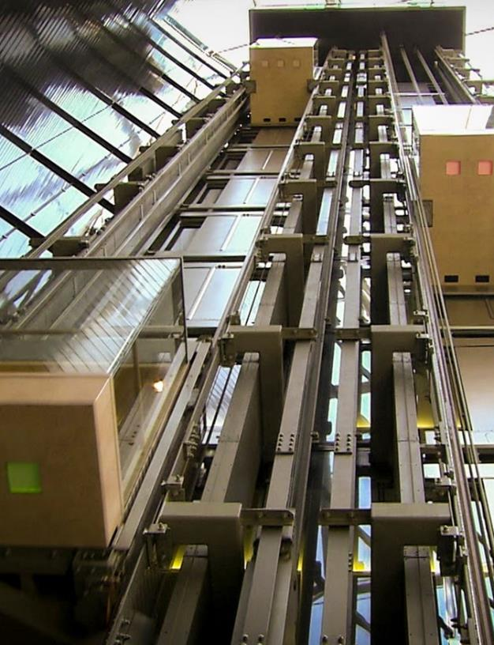





Manufacturing (2 of 2)
Transforming the urban landscape
Gathered data from sensors and systems to create valuable business intelligence and shift from reactive to proactive maintenance.
Click to learn more
Empowering global operations
Collected data from 40,000 sensors around the world to create a best-in-class forecast that helps customers make critical operational decisions.
Improving equipment to weather the storm
Gained visibility into equipment usage and a path to predictive maintenance using machine learning.

Slide 11
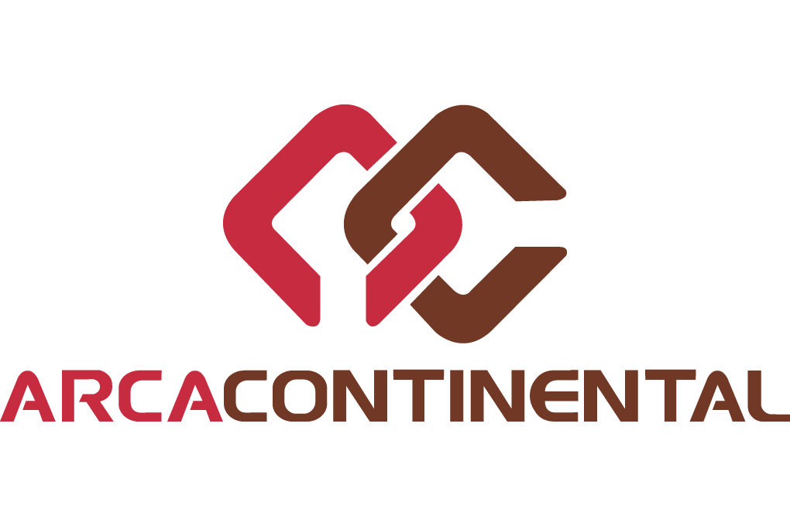



Retail
Connecting the unconnected
Gathered data from sensors and systems to create valuable business intelligence and shift from reactive to proactive maintenance.
Click to learn more
Data transforms beverage business
Increased the actionable insight pulled from company data across all areas of the company by deploying Microsoft Azure Machine Learning.
Click to learn more

Slide 12
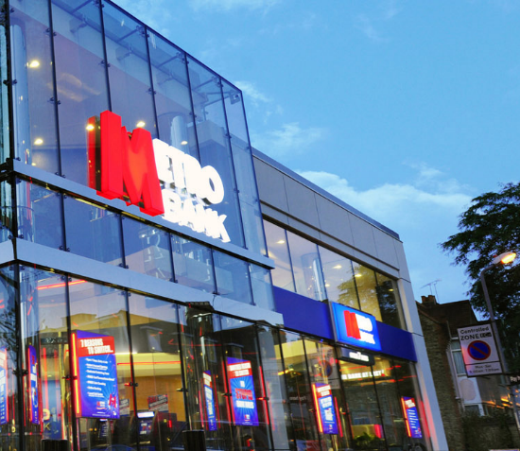




Banking
A growing bank's new approach
Leveraged company wide data to predict how likely customers are to go to other financial institution and drive better product features.
Click to learn more
Fast, friendly, and reliable banking
Developed a complete business intelligence suite to track company data in under a week in order to drive up engagement and accounts sharehold.
Click to learn more
Notes:
NOTE: Conversations with banking customers are really more about big data and advanced analytics. Even if you are in an IoT presentation, shift the conversation in the big data and advanced analytics direction, as it will be more relevant.

Slide 13




Government
The Internet of (Farm) Things
Deployed IoT sensors in different farms to learn how to optimize use of Maryland’s 93,000 acres of the farmland and maximize production.
Click to see more
How Glasgow is reinventing itself
Developed apps to help citizens use services and business find growth opportunities using data from IoT sensors across the city.
Click to see more

Slide 14

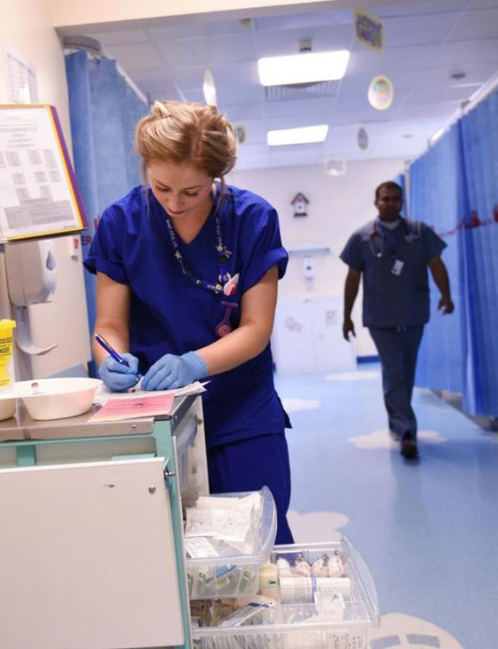
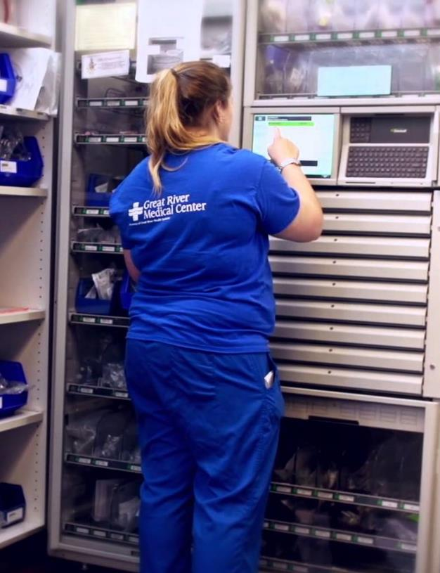



Health
Creating proactive, personalized healthcare
Using data from blood-pressure cuffs, pulse oximeters, and other devices, staff know to respond before the patient knows something is wrong.
Click to see more
Transforming healthcare with faster access
By capturing and analyzing data recorded in medical charts, staff were able to improve treatments techniques by tracking return visits.
Click to see more
Building a connected hospital
Reduce medication delivery times and inventory costs by connecting dispensary devices with electronic medical records.
Click to see more

Slide 15

Connect your things
Transform your business
Capitalizing on IoT
Turn data into insights
Notes:
Connect all your devices – Efficiency - reduce cost
Something about data management and transformation, actionable. – Innovation - improve offerings
Engage advanced analytics – Transformation - Add new business models
Connect = collect insights from devices
Get insights = get data and visualize it
Predict the next step = perform predictive outcome analysis, look at trends, guess what’s going to happen
Take action = transform back-end business processes, line of business integration. Based on the predictions, you can integrate with LOB solutions that take some kind of action – e.g. customer support.

Slide 16

Connect your things
Objective
Increase efficiency by reducing costs and eliminating bottlenecks
Organizational readiness
This is a great place to start if you have:
An identified business process you want to gain visibility into
An understanding of the kind of data you need in order to support your business objective
Devices capable of providing the type of data required
The IoT Customer Journey
Notes:
An efficiency initiative aims to:
Monitor and manage assets across the enterprise
Access device and environmental information in real time
Direct connected devices to execute tasks
Reduce the frequency of in-person service visits
Receive status alerts from connected assets when attention is needed
Deploy updates and promotions to connected devices
Fix issues remotely
Additional readiness
An idea of the kinds of asset monitoring and management tasks you want to perform

Slide 17


Turn data into insights
Objective
Drive innovation and increase revenue using your existing assets
Organizational readiness
This is a great place to start if you have :
The ability to interpret incoming data from devices
An understanding of the impacted business groups and processes
A plan for using data to drive business process improvements
The IoT Customer Journey
Notes:
An innovation initiative aims to:
Enable employees to make informed decisions
Design better, smarter, differentiated products
Deliver a better customer experience
Anticipate market trends and accelerate new product development
Improve customer service and loyalty with real-time insights and tailored offers
Additional readiness
A strong baseline of historical data (e.g. usage trends, maintenance records, etc.)
Accessible BI tools and resources that bring all data together into one view
An organizational commitment to data-driven operations and decision-making

Slide 18
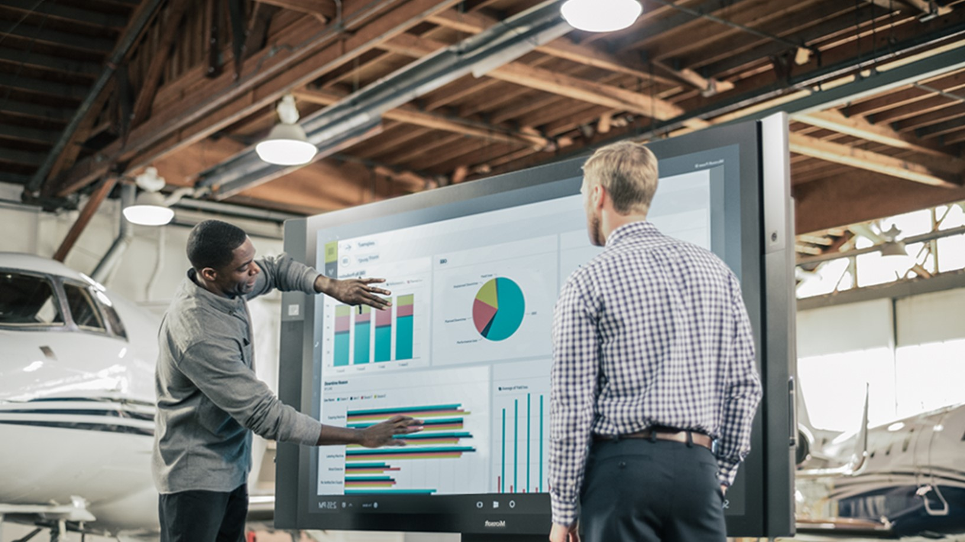
Transform your business
Objective
Create new lines of business and new business models
Organizational readiness
This is a great place to start if you have :
A strong baseline of historical device data (e.g. usage trends, repair records)
Visibility into real-time operational status
Predictive capability from advanced analytics
Stakeholder commitment to support change efforts
The IoT Customer Journey
Notes:
A business transformation initiative aims to:
Optimize operations with automated actions based on predictive insights
Pursue new revenue streams
Target new customers and markets
Develop profitable new business models
Deliver value-added services, or a product-as-a-service
Monetize the data you collect
Additional readiness
A defined business objective
An understanding of your target market
The ability to gather data from and manage connected assets

Slide 19
Enabling IoT solutions in your business with Microsoft

Slide 20

IoT projects can be complex
Difficult to maintain cohesive security
Time-consuming to stand up
Incompatible with current infrastructure
Hard to scale

Slide 21

Azure IoT Suite
Device Connectivity & Management
Data Ingestion and Command & Control
Stream Processing & Predictive Analytics
Workflow Automation and Integration
Dashboards and Visualization
Preconfigured Solutions
Remote Monitoring
Predictive Maintenance

Slide 22
Gain defense in depth with Azure IoT Suite security
Securely connect millions of devices . . .
Over a secure internet connection . . .
To Microsoft Azure – built with security from the ground up
Device Security
Device Provisioning and Authorization
Connection Security
X.509/TLS-Based Handshake and Encryption
Cloud Security
Azure Security Center
Azure Active Directory
Key Vault
Policy-Based Access Control
101010101101010110100010101010101110100010111
1010101011001010110100010101010101110100010111

Slide 23
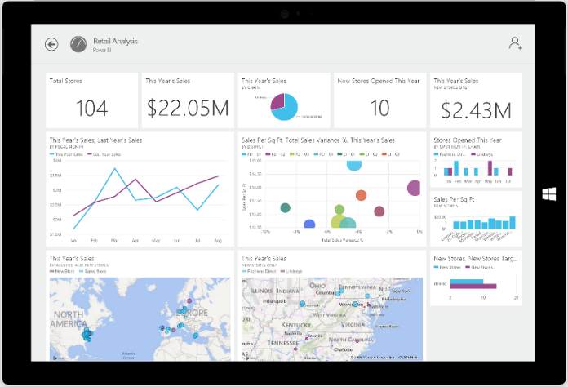
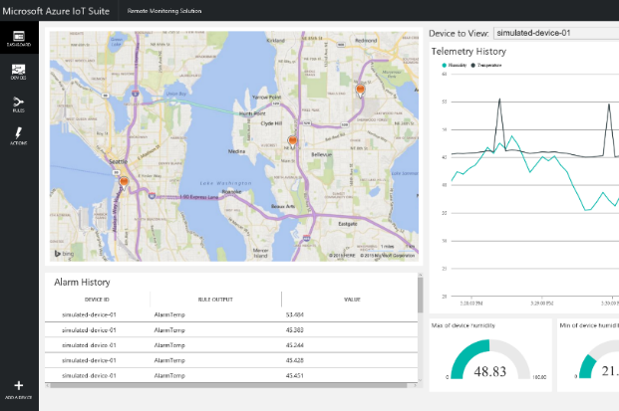
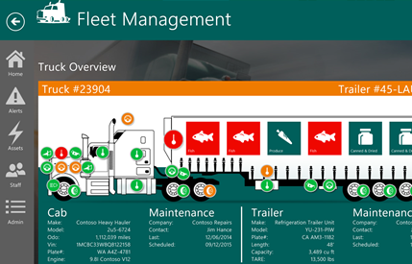
Accelerate time to value with preconfigured solutions
Start quickly for common IoT scenarios
Finish with your Internet of Things application
Get started in minutes
Modify existing rules and alerts
Add your devices and begin tailor to your needs
Fine-tuned to specific assets and processes
Highly visual for your real-time operational data
Integrate with back-end systems
Notes:
Talking Points
Another area of our focus, a point of differentiators, are the preconfigured solutions.
Within Azure IoT Suite, we’ve provided preconfigured solutions that allow you to get started very quickly for common IoT scenarios such as remote monitoring and predictive maintenance.
You basically get a curated experience for these scenarios
With a pre-provisioned dashboard, rules and events engines and a device registry.
You can add new devices, change rules and quickly get started to PoC.
This really allows you to get the end point, i.e. building your IoT solutions.
- For example, you get started quickly with the remote monitoring solution that you then tailor to your needs and convert it into a fleet management solution.
This solution is finely tuned for your needs, etc.
Transition
Our goal with these preconfigured solutions is to help you accelerate time to value and reach your end point much faster because we’ll give you a good base to start building from.

Slide 24
What you get with remote monitoring preconfigured solution
Devices
Azure IoT Suite Remote Monitoring
Back end systems and processes
Web/ Mobile App
Storage blobs
DocumentDB
C# simulator
IoT Hub
Stream Analytics
Event Hub
Web Jobs
Logic Apps
Notes:
How does it work? As mentioned; the solution is a combination of multiple back-end components. This architecture diagram shows the individual Microsoft products and services that are utilized.
Reference Architecture for Remote Monitoring solution, what products are used and why? ->
Provision simulated devices with a C# device emulator running .Net. Create agents for Linux, iOS, Android and other platforms with C and Java language support.
IoT Hub manages the two way communication between cloud and device and creates a secure command and control channel.
Azure Stream Analytics creates and manages jobs to recognize threshold values or detect alarm triggers, sending this information where it needs to be escalated.
Event Hub is queried by a web job running an event processor host to determine where and alarm or alert needs to be pushed – such as sending an alert to dashboard for a human operator to take action.
Logic Apps are used to create more complex work loads and integrate into line of business and other proprietary applications.
Document DB stores all the metadata and device properties for each connected device.
Blobs store telemetry information and telemetry data. Other tools such as Azure Machine Learning and PowerBI can access this information for data visualization or processing advanced analytics.
Webapp – Dashboard code is available in Github allowing it to be fully customized by the user to align with a scenario or be relevant for an enterprise application.
Azure Active Directory controls user ID’s and access, allowing the service to be shared with relevant decision makers within the business but restrict access to certain controls or devices.
PowerBI is used for both open-source embedded components within the dashboard and also for complex external analytics of trends and patterns across all stored data.

Slide 25



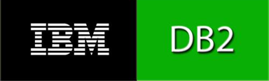


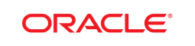




Obtain flexibility with an open approach
Work with any device
Connect to existing solutions and business processes
Devices
Operating Systems
Business solutions and processes
Microsoft Dynamics
RTOS
Languages
Protocols
C
Node.js
Java
.NET
Python
MQTT
HTTP
AMQP
LwM2M
And other business systems
Using…
Using…
Azure IoT Hub
Device SDK
Gateway SDK
Windows 10 IoT Core
Device Management
Power BI
Azure App Service
Azure Mobile Apps
Azure API Management
Azure Logic Apps

Slide 26
Benefit from a hyper-scale footprint
30
Azure regions around the world
Azure regions
More than AWS and Google Cloud combined

Slide 27
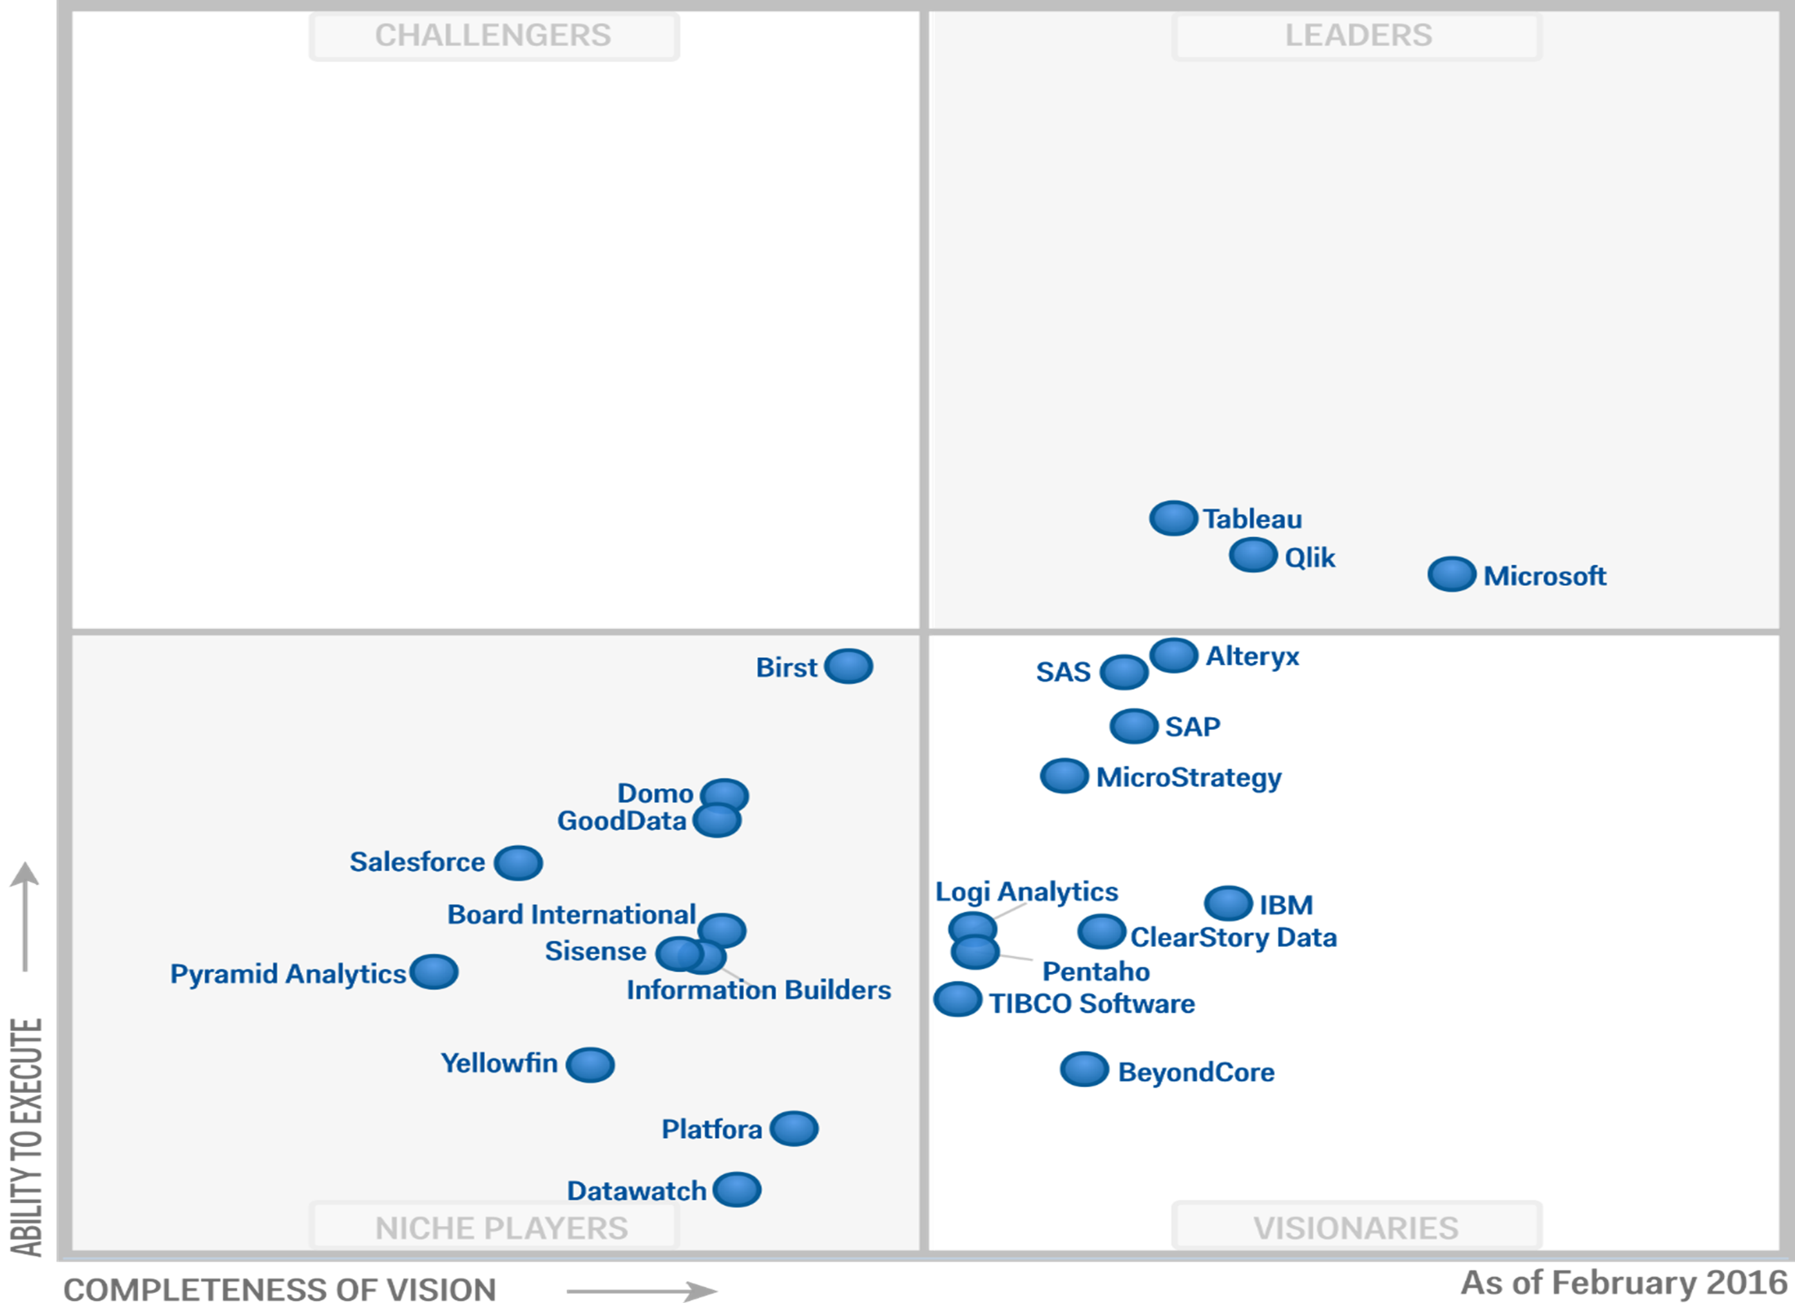
Unlock insights from any data
Rich data storage and analytics ecosystem
Gartner Magic Quadrant for Business Intelligence and Analytics Platforms
Data Platform
 | SQL Database
 | Redis Cache
 | DocumentDB
 | SQL Data Warehouse
 | Search
 | Tables
Data Analytics
 | Machine Learning
 | Stream Analytics
 | HDInsight
 | Data Factory
 | Data Lake & Analytics
*February 2015. The Gartner Magic Quadrant for Business Intelligence and Analytics Platforms is the property of Gartner, Inc. and available upon request from Microsoft. Gartner does not endorse any vendor, product or service depicted in its research publications, and does not advise technology users to select only those vendors with the highest ratings or other designation. Gartner research publications consist of the opinions of Gartner's research organization and should not be construed as statements of fact. Gartner disclaims all warranties, expressed or implied, with respect to this research, including any warranties of merchantability or fitness for a particular purpose. The above graphics were published by Gartner, Inc. as part of a larger research document and should be evaluated in the context of the entire document.

Slide 28
Azure IoT Suite: Ready for the enterprise
From endpoint to insight to action, across the enterprise, and around the world
Secure
End-to-end
Fast
Start in minutes
Open
Connect anything
Scalable Grow effortlessly
From endpoint and connection through to data and the cloud
Preconfigured solutions for the most common IoT scenarios
Any device, OS, data source, software, or service
Millions of devices, terabytes of data, on-premises and in the cloud, in 30 regions worldwide
Devices
Gateways
Data
Insights
Action
People
Magic Quadrant Leader, Business Intelligence and Analytics Platforms*
Built on the industry’s leading cloud
*February 2015. The Gartner Magic Quadrant for Business Intelligence and Analytics Platforms is the property of Gartner, Inc. and available upon request from Microsoft. Gartner does not endorse any vendor, product or service depicted in its research publications, and does not advise technology users to select only those vendors with the highest ratings or other designation. Gartner research publications consist of the opinions of Gartner's research organization and should not be construed as statements of fact. Gartner disclaims all warranties, expressed or implied, with respect to this research, including any warranties of merchantability or fitness for a particular purpose. The above graphics were published by Gartner, Inc. as part of a larger research document and should be evaluated in the context of the entire document.

Slide 29
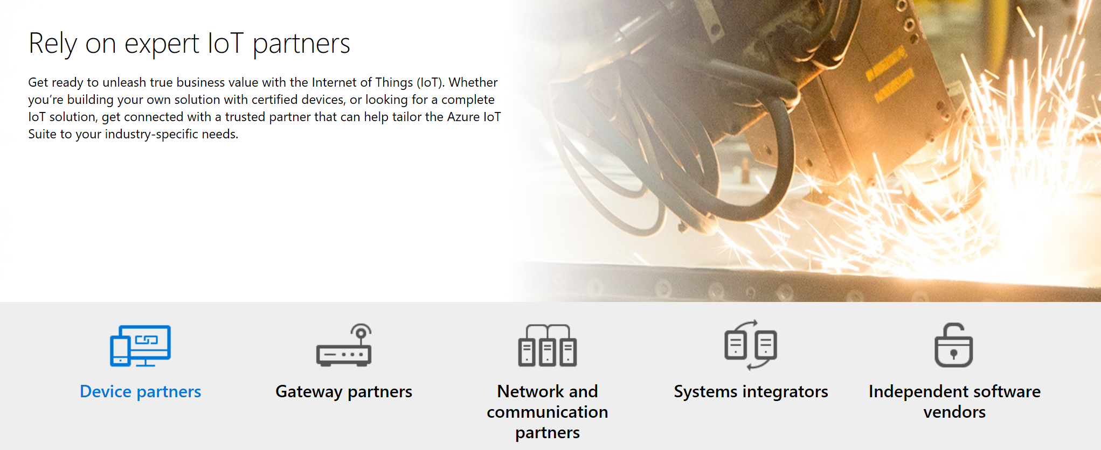
An ecosystem ready to support your IoT needs
Find a Partner
https://www.microsoft.com/en-us/cloud-platform/internet-of-things-partners

Slide 30

Get started today
Go to www.InternetOfYourThings.com
Connect with your regional IoT team
Define your use case
Select a partner
Go through our Quick Start process

Slide 31

Thank you

Slide 32
Appendix

Slide 33
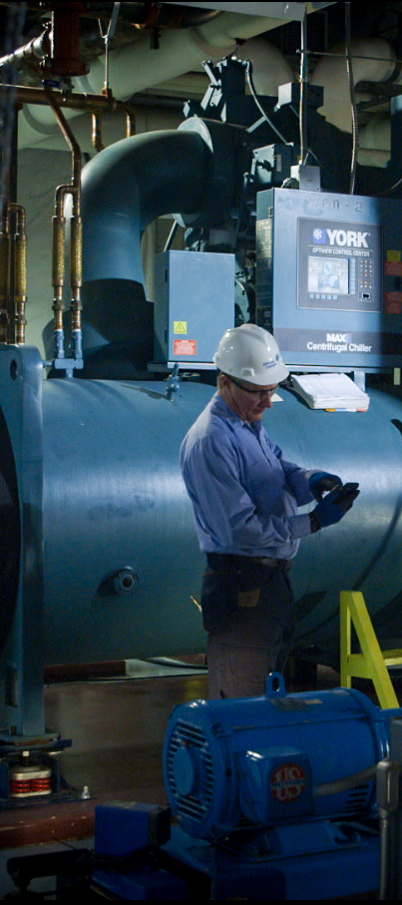
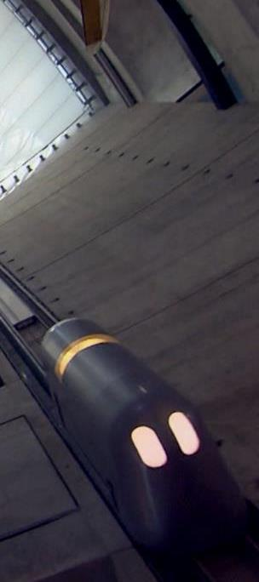
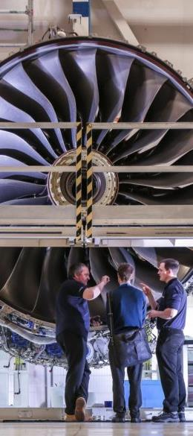





Chillers now run 9x faster than unconnected equipment, avoiding more than $300,000 in hourly downtime costs
Gathers data from sensors and systems to create valuable business intelligence and reduce downtime by 50%
Cutting fuel usage by 1 percent could save $250,000 per plane per year
Improves access to production and supply chain data worldwide, reducing downtime costs by as much as $300,000 per day
Notes:
Read read
But don't just take our word for it. What's hear firsthand from some of our customers.

Slide 34

Take advantage of the broader Microsoft IoT stack
Intelligent Devices
Intelligent Connectivity
Intelligent Insights
Intelligent Actions
Windows 10 IoT
Azure IoT Suite
Cortana Intelligence Suite
Dynamics 365

Slide 35
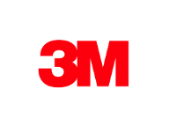





























Azure IoT

Slide 36

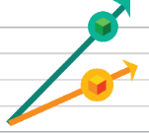

Business is powered by the cloud
“Cloud is a given. CIOs no longer ask whether they should use cloud, but rather how.”*
Improve efficiency
“Traditional on-premises data storage is four times the cost of cloud storage.”**
Enable innovation
“55% of CIOs indicated they would source all their critical apps in the cloud by 2020.”***
Transform your business
“Seventy percent of CIOs will embrace a cloud-first strategy by 2016.”****
Reduce costs and inefficiencies
Increase revenue with existing assets
Create new business models
*”Cloud Evolves From Point Solution To Strategic Enabler Of The New Connected Economy,” Forrester, Liz Herbert, January 2015
**Forrester, 2014
***Smith, David Mitchell et al. Predicts 2014: Cloud Computing Affects All Aspects of IT. Gartner, Inc. December 4, 2013.
****IDC, CIO webinar, 2014
Notes:
Stats from Sunil:
Predictive maintenance –
Predictive maintenance could reduce factory upkeep cost by 10 percent to 40 percent. It will also foster better maintenance, resulting in a 50 percent reduction in downtime, simultaneously shrinking equipment and capital investment by 3 percent to 5 percent by extending machine life. $630 Billion value.
http://www.iotsolutionprovider.com/industrial/how-iot-can-support-a-dynamic-maintenance-program
This may be old but IDC has said 90% data will be in cloud for IoT
https://www.idc.com/getdoc.jsp?containerId=prUS25291514
Colin M also has some stats

